Slide 1
Cancer Biology Biol 445
Spring 2020
Dr. Heidi Super
Lecture 13
2-21-2020

Slide 2
Dr. Badie Alakech—What did you think about the experience?
Are you interested in more “field trips”?

Slide 3
Where were we?
We discussed how MMP inhibitors were a major focus of cancer research for a time.
Like angiogenesis, metastasis is not tumor-specific and a step in tumor progression that makes a tumor life threatening.
Inhibiting metastasis seems like a perfect mechanism for cancer treatment
But like angiogenesis inhibitors…Metastasis inhibitors (Such as MMP inhibitors) don’t work that well in humans.

Slide 4
Still….
Review the genes that play a role in metastasis.
Review some of the inhibitors that have been developed.
Think about reasons why some “great ideas” for cancer drugs may not work as well as hoped.

Slide 5
Chapter 9--Oncogenes
Recall---any “cancer gene” is really a mutant allele of a normal cellular gene.
In this sense, cancer is not like a viral infection, where someone with cancer has acquired something which is completely absent from someone without cancer.*
*There are only a few exceptions in humans, in which a virus brings into a human cell, a gene which transforms that cell from normal to cancer.

Slide 6
Some human cancers with a link to acquired viral infection
Name them?....

Slide 7
Back to the genetic links to most human cancers….
Normal cells are said to have proto-oncogenes.
The name implies association with cancer, but these are normal, essential genes encoding proteins which activate cell division or promote cell survival.
Removing “proto”---oncogene is the version of the gene associated with cancer cells.

Slide 8
Proto-oncogene discovery
Very interesting and surprising!
Started with transfection experiments. (DNA transfer from tumor cells to normal cells)
Figure 2-20

Slide 9
Something in tumor-associated DNA transforms cells

Slide 10
Recall…
In cancer biology, transformation means something very specific.
Explain.

Slide 11
The first transfection experiments used total DNA from tumor cells.
Techniques developed in the early 80s allowed isolation and transfer of ever smaller amounts of DNA until individual genes were identified which greatly increased proliferation of cells.
Gene cloning= isolating a single gene based on its activity.

Slide 12
E.g. The first oncogene discovered in humans is called RAS
Came from human bladder cancer cells
Had strikingly similar DNA sequence to gene found in a virus that infects rats and causes rat sarcomas.

Slide 13
Humans vs. other mammals…
Non-human animals frequently do become infected with viruses that carry oncogenes.
Chickens, rats, mice, cats, monkeys---get a variety of cancers from oncogene-containing viruses.
In fact, the first oncogene isolated from any source was noted in a virus that causes sarcomas in chickens—the gene is called src. (We will return to this in chapter 4 and 7)

Slide 14
So where did the RAS oncogene come from?...
—It turns out that throughout evolution, viruses have picked up genes from their hosts’ genomes, which enhance the propagation of the virus. Genes which increase cell division in their host are usually a good thing for a virus. It gives the virus more cells to infect and more opportunity to replicate.

Slide 17
Keep in mind…
Every oncogene in the table has a cellular counterpart proto-oncogene, in cells of animals.

Slide 19
RAS
RAS is part of the human genome. It is a proto-oncogene that is important for cell division. It’s normal and needed!
RAS was not unique. Several virus-associated oncogenes turned out to have cellular (from the host cell) counterparts.
Much of the discovery was made by a pair of scientists, Harold Varmus (recent director of the NCI, and Michael Bishop)
1989 Nobel prize---To Harold Varmus and Michael Bishop.
Google them. See where their careers have gone.

Slide 21
So how can the proto-oncogene like RAS become an oncogene?
What types of alterations would you expect in oncogenes? Recall the general role of oncogenes in the cell cycle?
Mutations in oncogenes are typically gain of function.

Slide 22
Several mechanisms
1. Point mutation:
Most RAS oncogenes in human cancers, have only one nucleotide substitution compared to the normal RAS sequence.
The only difference in the oncogenic Ras protein and the normal Ras protein is a single amino acid change. Figure 9-1

Slide 23
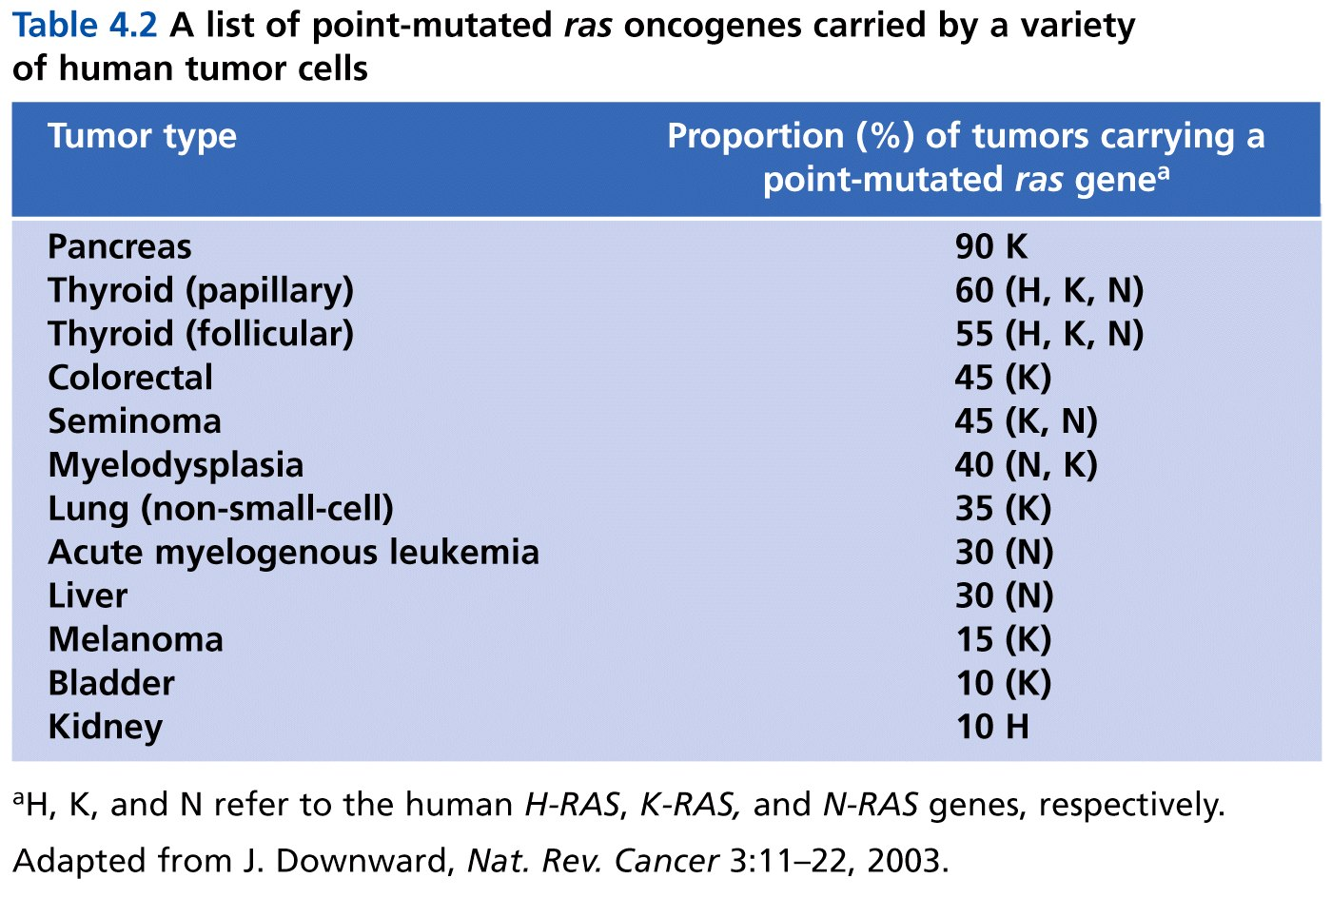
Table 4.2 The Biology of Cancer (© Garland Science 2007)

Slide 24
Some carcinogens (cancer causing mutagens) seem to target specific oncogenes, like RAS with point mutations.
Asbestos
Vinyl chloride
DMBA

Slide 25
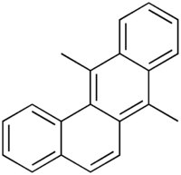
7,12-dimethylbenzo[b]phenanthrene
DMBA= one of the most potent, organ-specific tumor initiators used in cancer studies. Induces mammary tumors in rodents. Why/how? Point mutation in Ras.

Slide 26
AROMATIC AZO DERIVATIVES PREVENTING MAMMARY
CANCER AND ADRENAL INJURY FROM
7,12-DIMETHYLBENZ(a)ANTHRACENE*
BY CHARLES HUGGINS AND JOHN PATAKI
THE BEN MAY LABORATORY FOR CANCER RESEARCH, UNIVERSITY OF CHICAGO
Communicated February 18, 1965

Slide 27
Charles Huggins won a Nobel prize (1966) for his work on breast cancer. He was among the first to identify a link between hormones and tumors/tumor progression.
He shared the prize with Peyton Rous who independently discovered tumor-inducing viruses! (Rous sarcoma virus and the src gene)

Slide 28
Connection to human cancer…
Cellular proto-oncogenes can become oncogenes in a similar way as viruses acquire oncogenes.
Point mutations
Amplification
Chromosome rearrangements

Slide 29
Study oncogenes---practice writing out their discovery in non-human animal viruses.
It’s complex---often misunderstood. Read and read and read and write and draw until it is clear.

